Slide 1
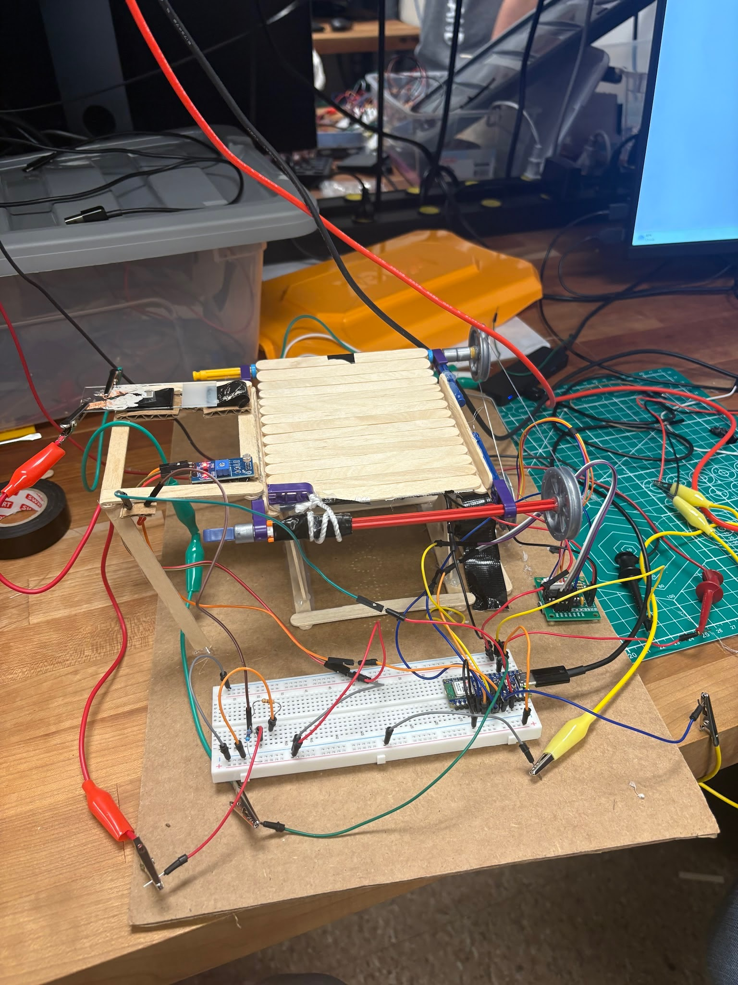
Sensing the World Final Project
Automated roof system with Arduino Nano ESP32
Max Weiner, Justin Ficca, JB Volkert

Slide 2
Introduction and Project Overview
Concept
Retractable Roof based on environmental conditions
Applications
Patio cover
Sporting Arena Roof
Notes:
max

Slide 3
Constraints
Requirements
Limited to Materials in Keysight Lab
Complete by project deadline
Must improve quality of life
Must include moisture sensor, one other sensor, arduino nano, LED, and motor
Notes:
JB

Slide 4
Inputs and Outputs
Moisture Sensor(Analog)
Light Sensor(Binary)
Arduino Nano ESP32 Controller
Stepper Motor to actuate roof
Software
Rocker Switch(Binary)
Flashing LED

Slide 5

Implementation Overview
Design Process -
Defined Functionality and Scope
Assigned responsibilities
Generated possible ideas
  Swing arm
  Roll-up roof
Create initial prototypes
Iterate and test
Notes:
JB

Slide 6
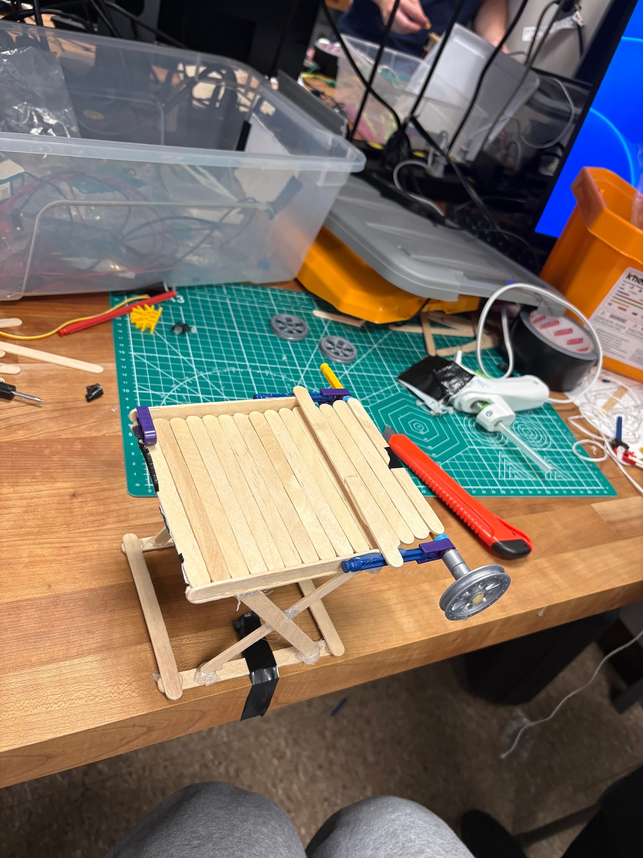
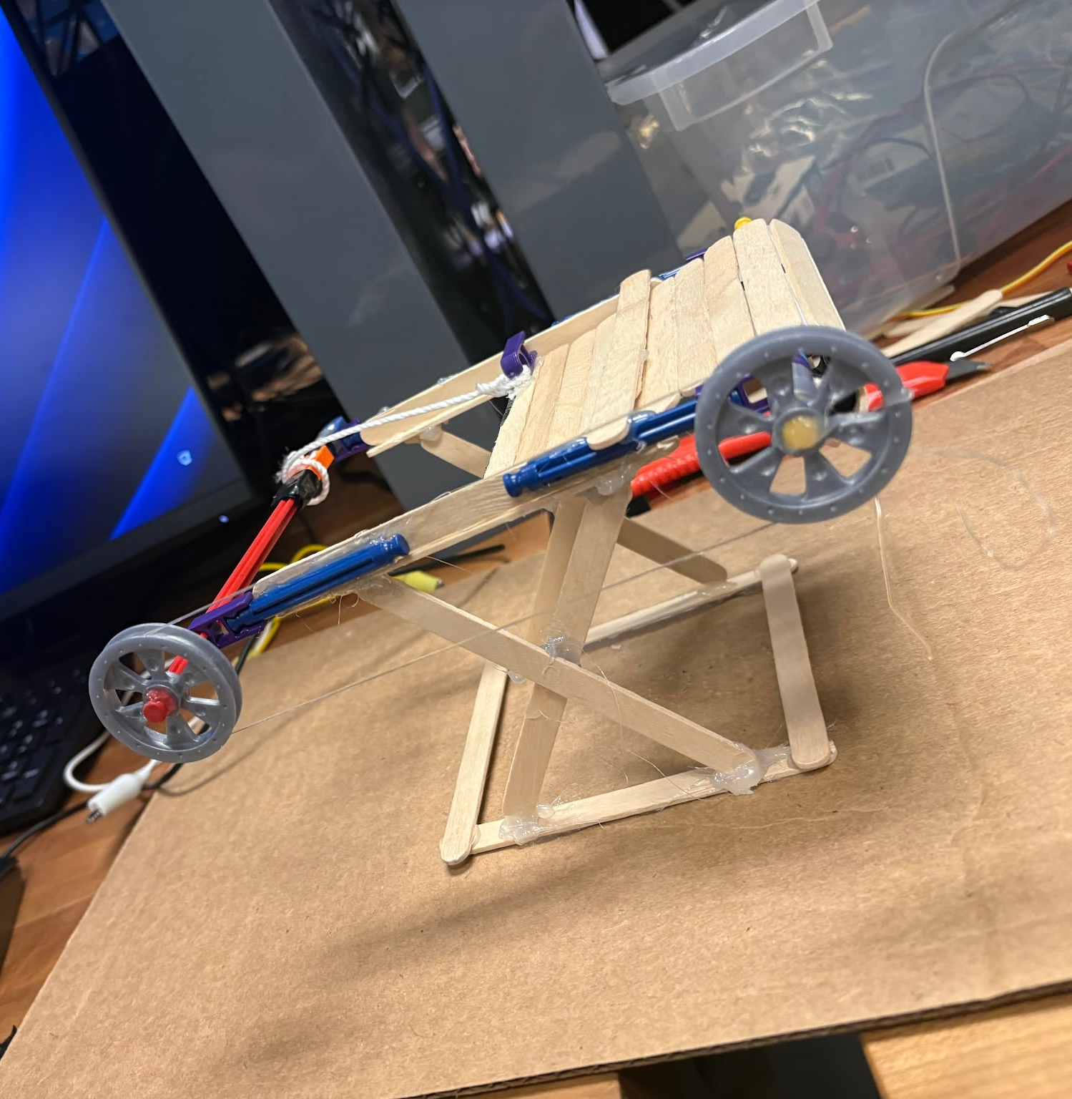
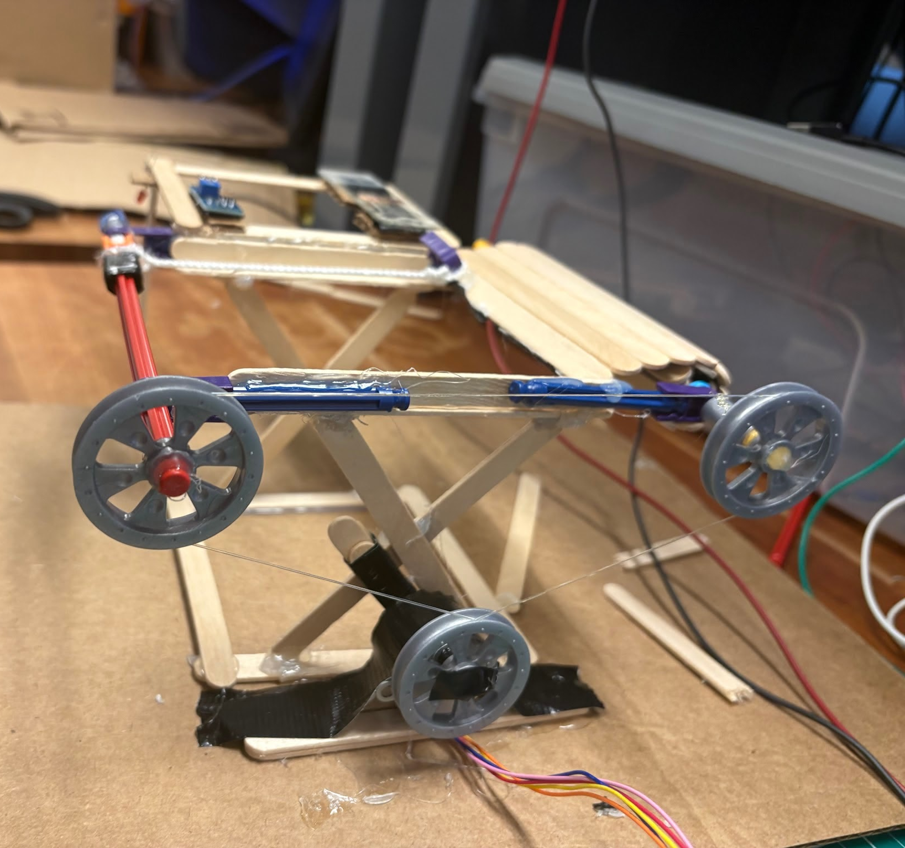
Developing Mechanical Concept
Initial Design added pulling string Integrated motor
Notes:
JB

Slide 7
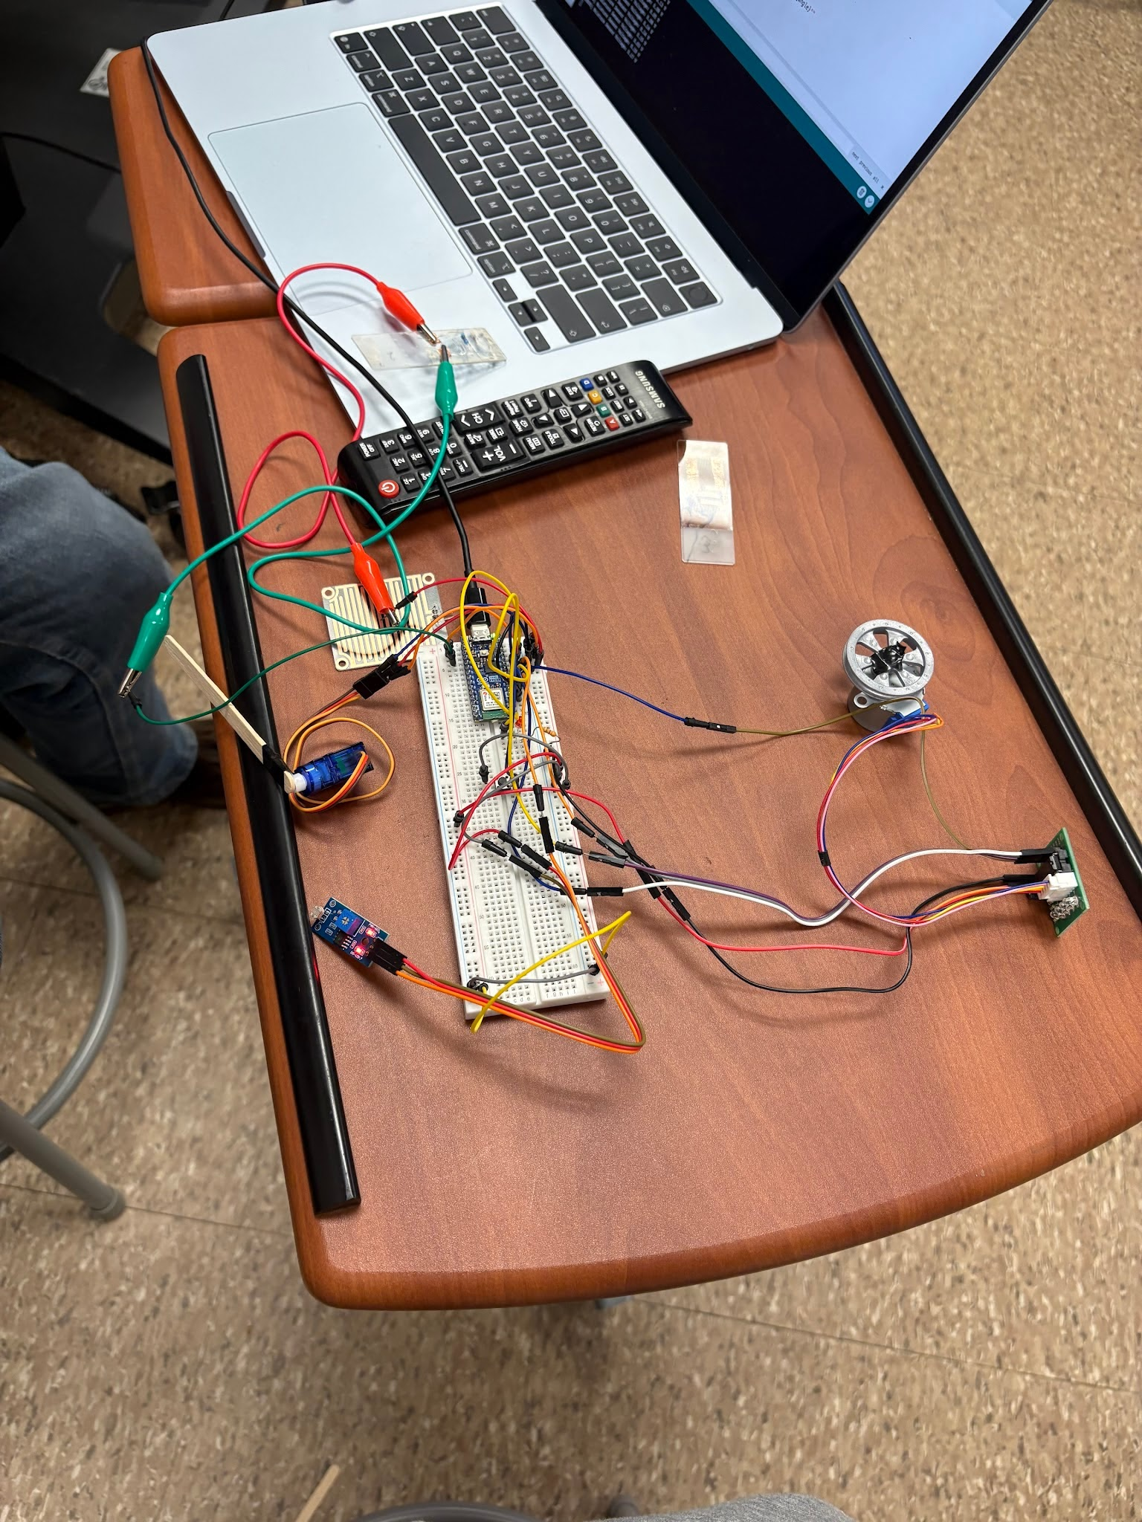
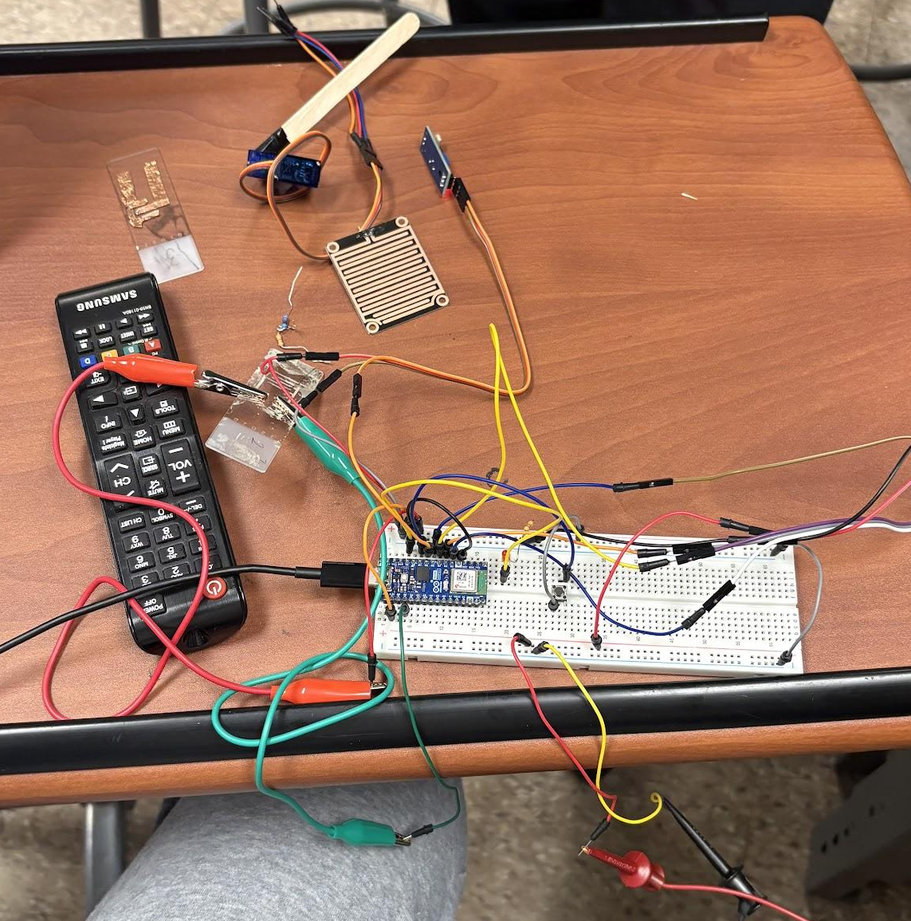
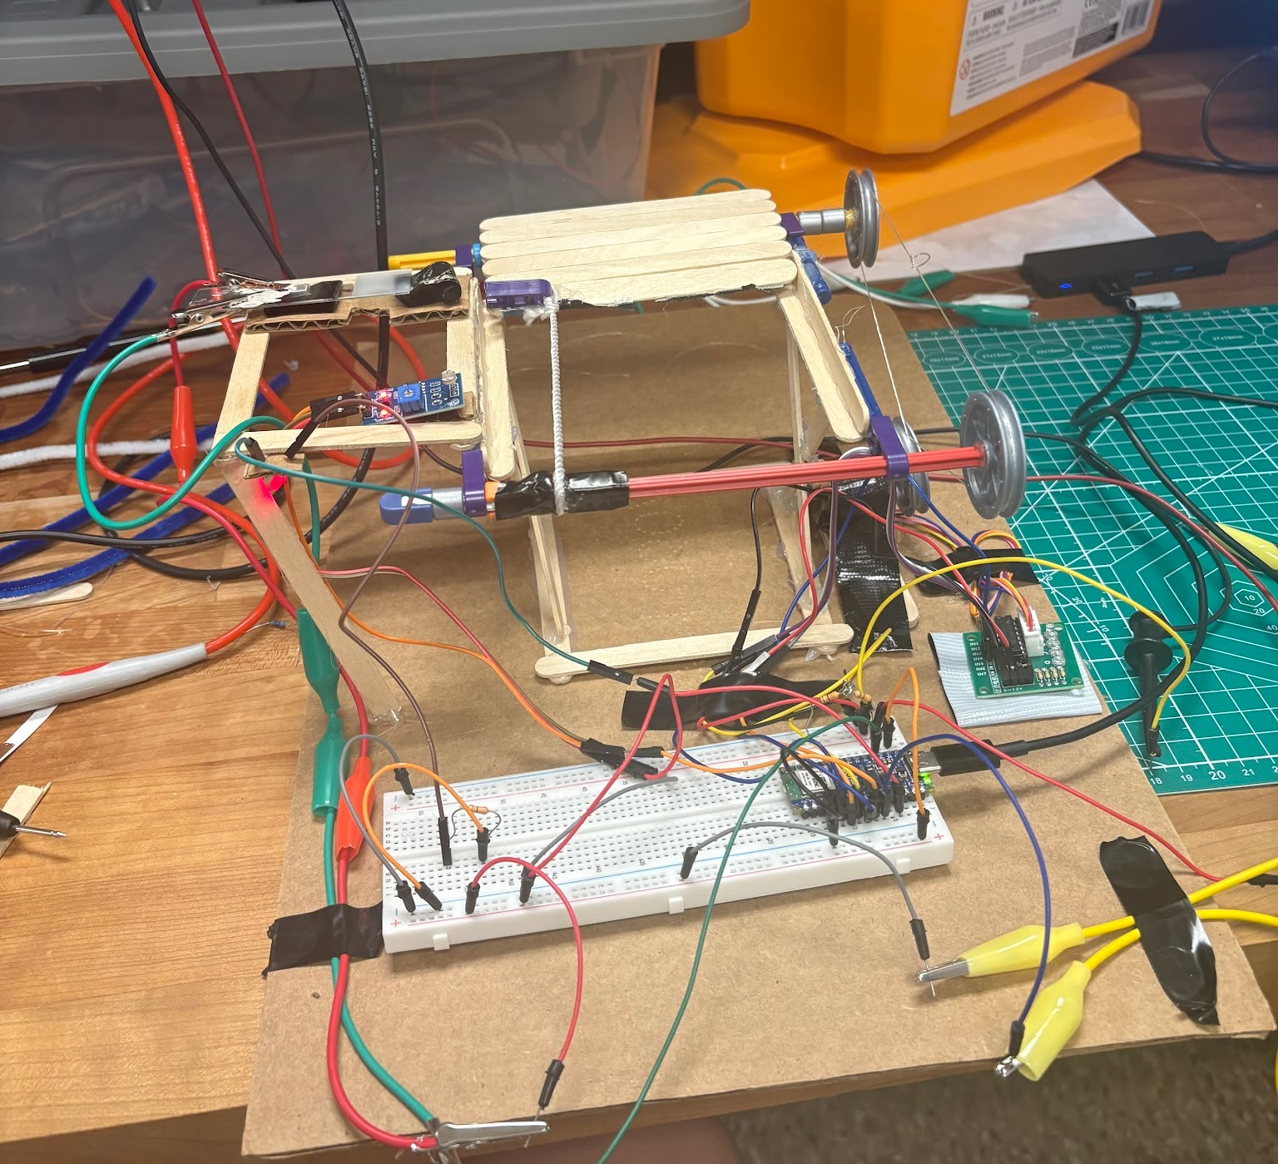
Creating Electrical Systems
Testing different motors Integrating sensors putting it all together
Notes:
max

Slide 8

Results-Full Implementation

Slide 9

Use of AI
Google Gemini 3.6 Thinking model used for creating and editing all code

Slide 10
Successes
LED
Stepper Motor
Sensors
Switch
Mechanical roll-up roof

